Slide 1
Supercharge Your ALM: Committing, Merging and Building

Slide 2



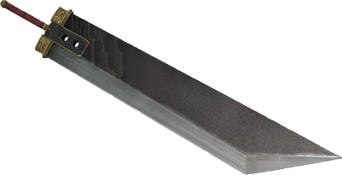
Speaker Blog
Nathan Clouse
Technical Solution Architect
MCA Connect, LLC
AXUG Summit Track Leader 2018/19
Nathan.clouse@mcaconnect.com
www.atomicax.com
@NathanClouseAX

Slide 3

Topics
Azure DevOps
Boards and dashboards
Extensions
Work Items
Repos
TFVC vs GIT
Branching
Changesets and Shelvesets
Policies
Pipelines
Builds
Continuous Integration
Gated Check Ins
Gated Check Ins with Tests
Release
To LCS
To an environment

Slide 4
Azure DevOps

Slide 5
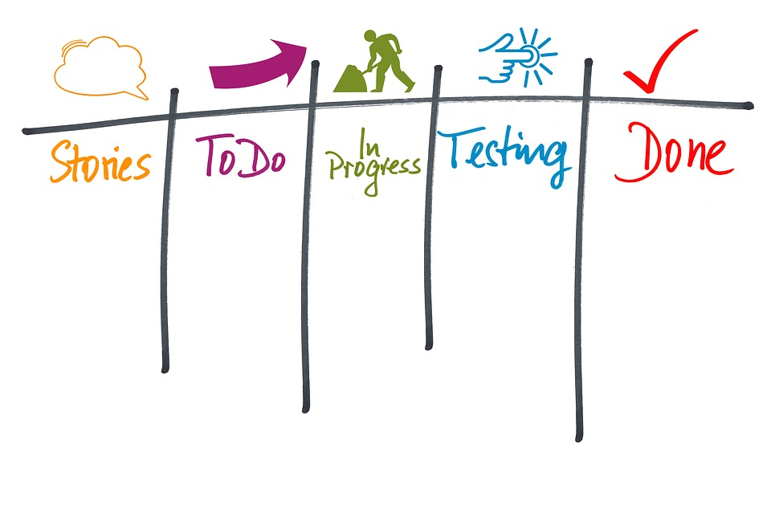
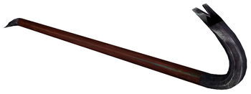
Boards
Use Kanban boards
visual representation of work and work state
Simple, easy to use command center for activity

Slide 6
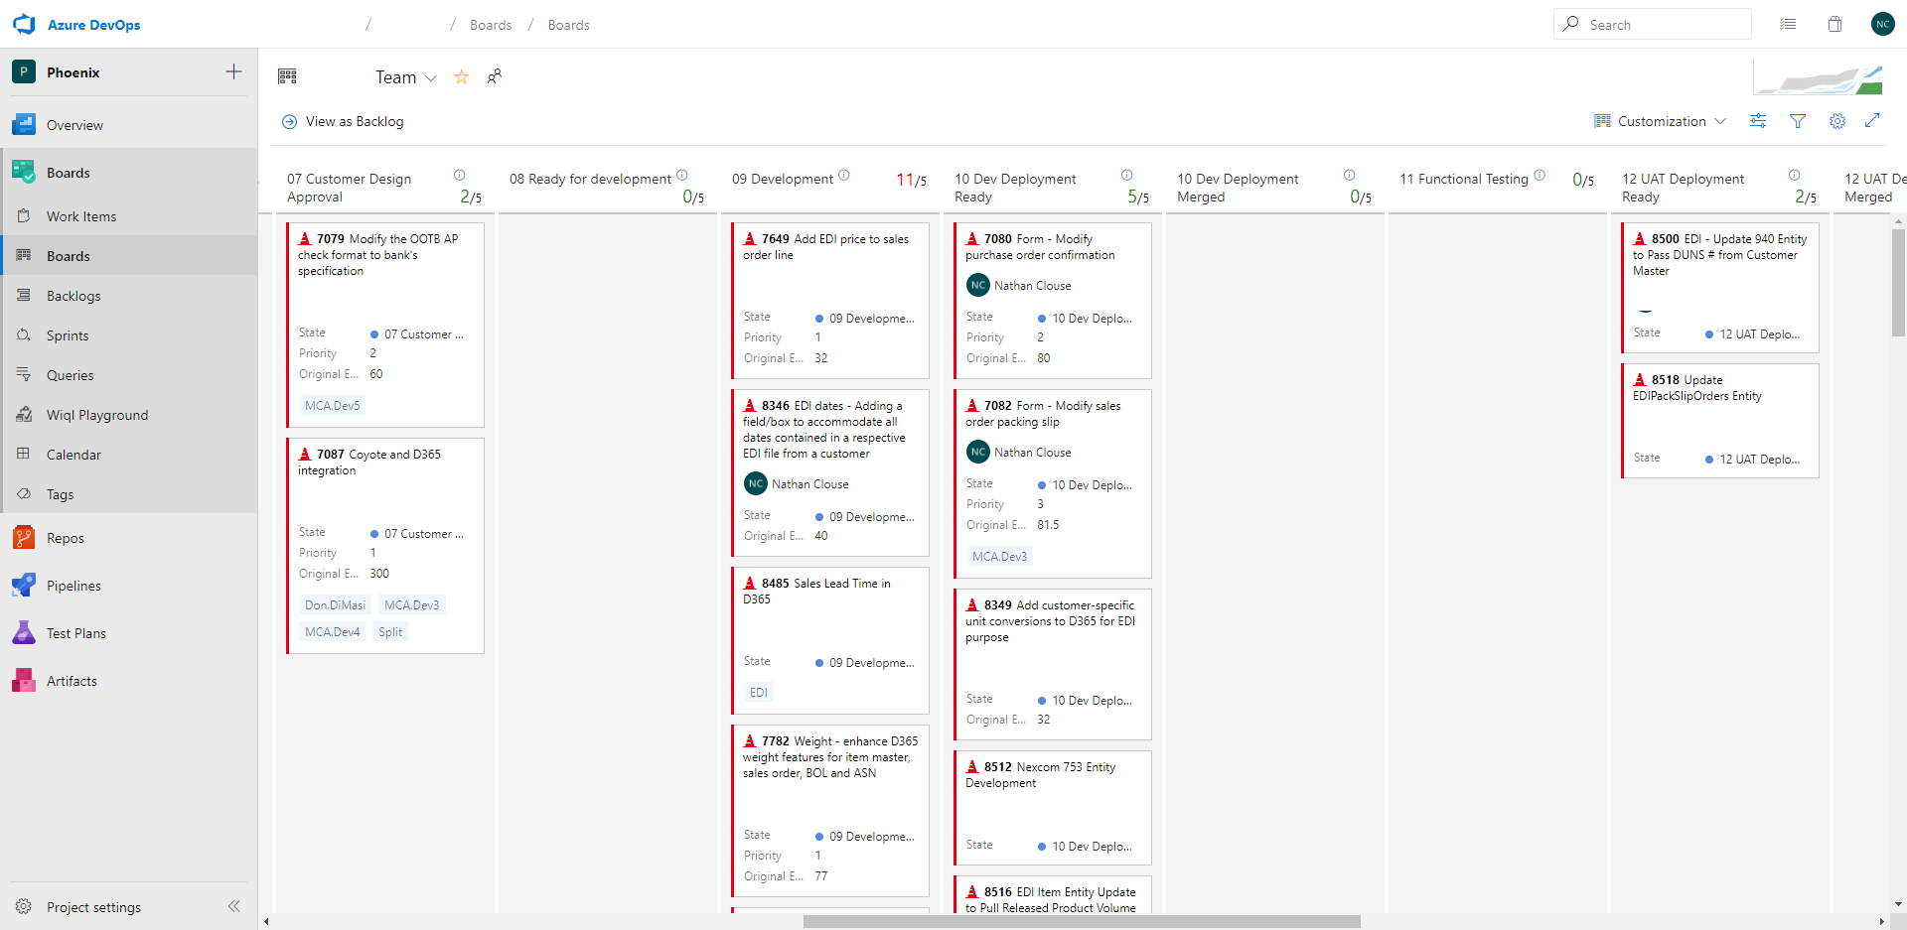

Slide 7
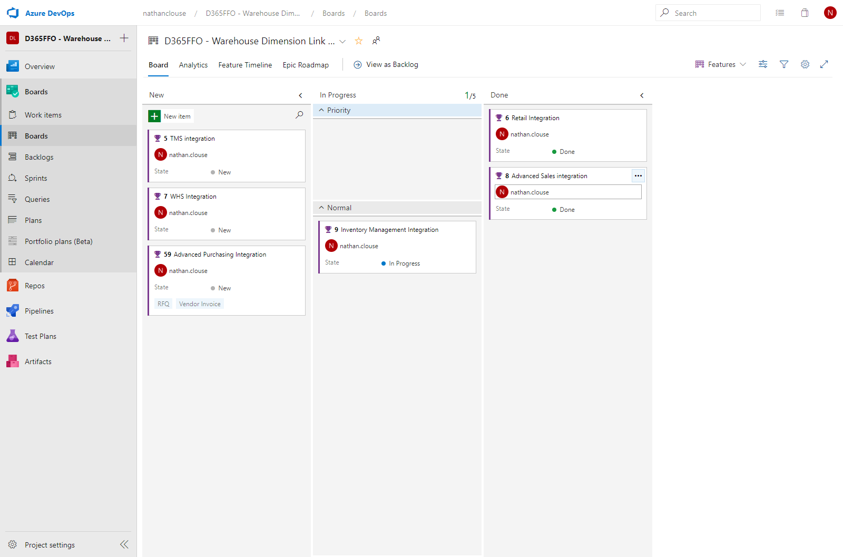

Slide 8
Extensions
Extend Azure DevOps (AZDO)
Add new abilities, widgets, visualizations, behaviors to AZDO
Favorites
Code search, Analytics, Countdown widget, delivery plans, test case explorer, work item details, team calendar, team project health, branch visualization and Dynamics 365 Finance and Operations Tools
Visit the marketplace for more or create your own

Slide 9
Repos

Slide 10

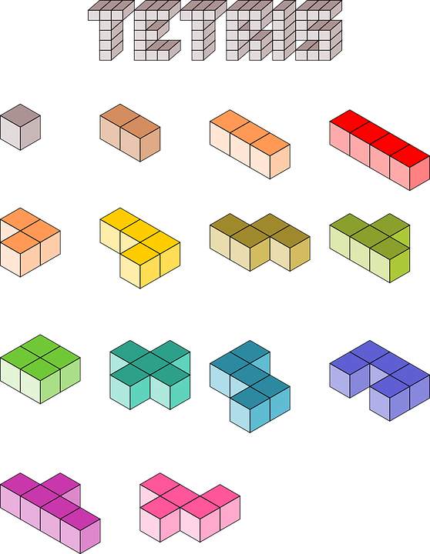
TFVC
Supported
Build scripts work
MSFT documentation
“Classic” experience
Native – no extra work

Slide 11


GIT
Projects
Need to relocate or not track
Work Offline
Branching
Per work item
Reviews
Pull Requests
Not Supported

Slide 12


TFVC GIT
TFVC
Supported
Familiar
Lots of OOTB value
GIT
Not Supported
Modern
Pull Requests

Slide 13

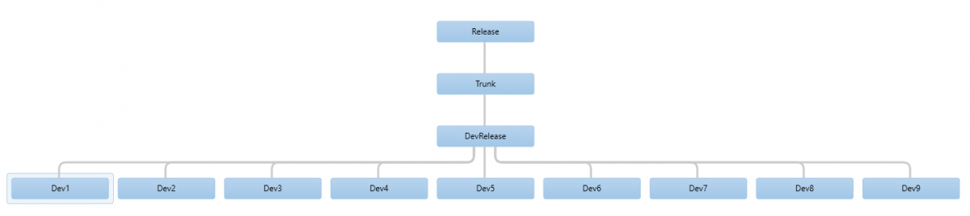
Branches - TFVC

Slide 14
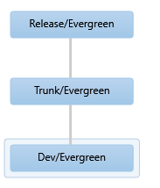

Branches - TFVC

Slide 15
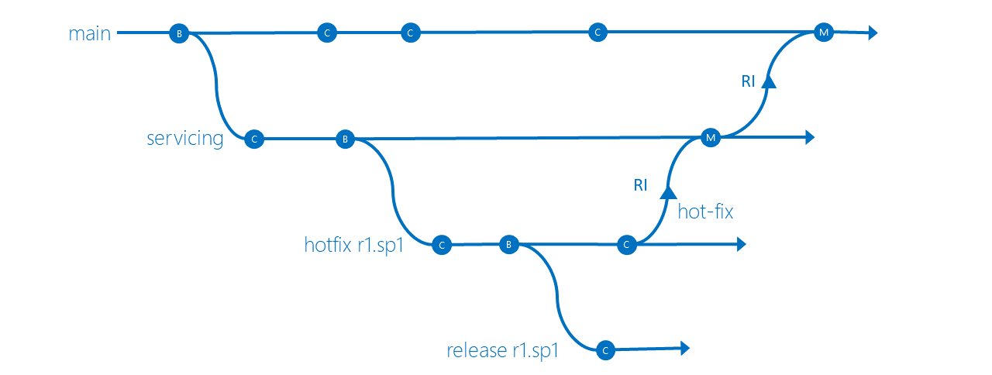
TFVC - General

Slide 16
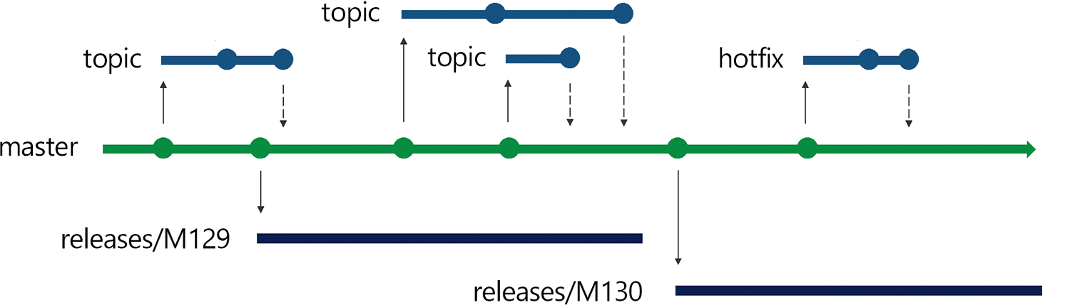
GIT - General

Slide 17
Changesets
Checked in code as a set of changes associated with a work item
Exist in a branch
Must merge to other branches
Problems
Dude, where’s my code?
Seriously, where is it?
Push based
Lots of activity can take a while to reconcile

Slide 18
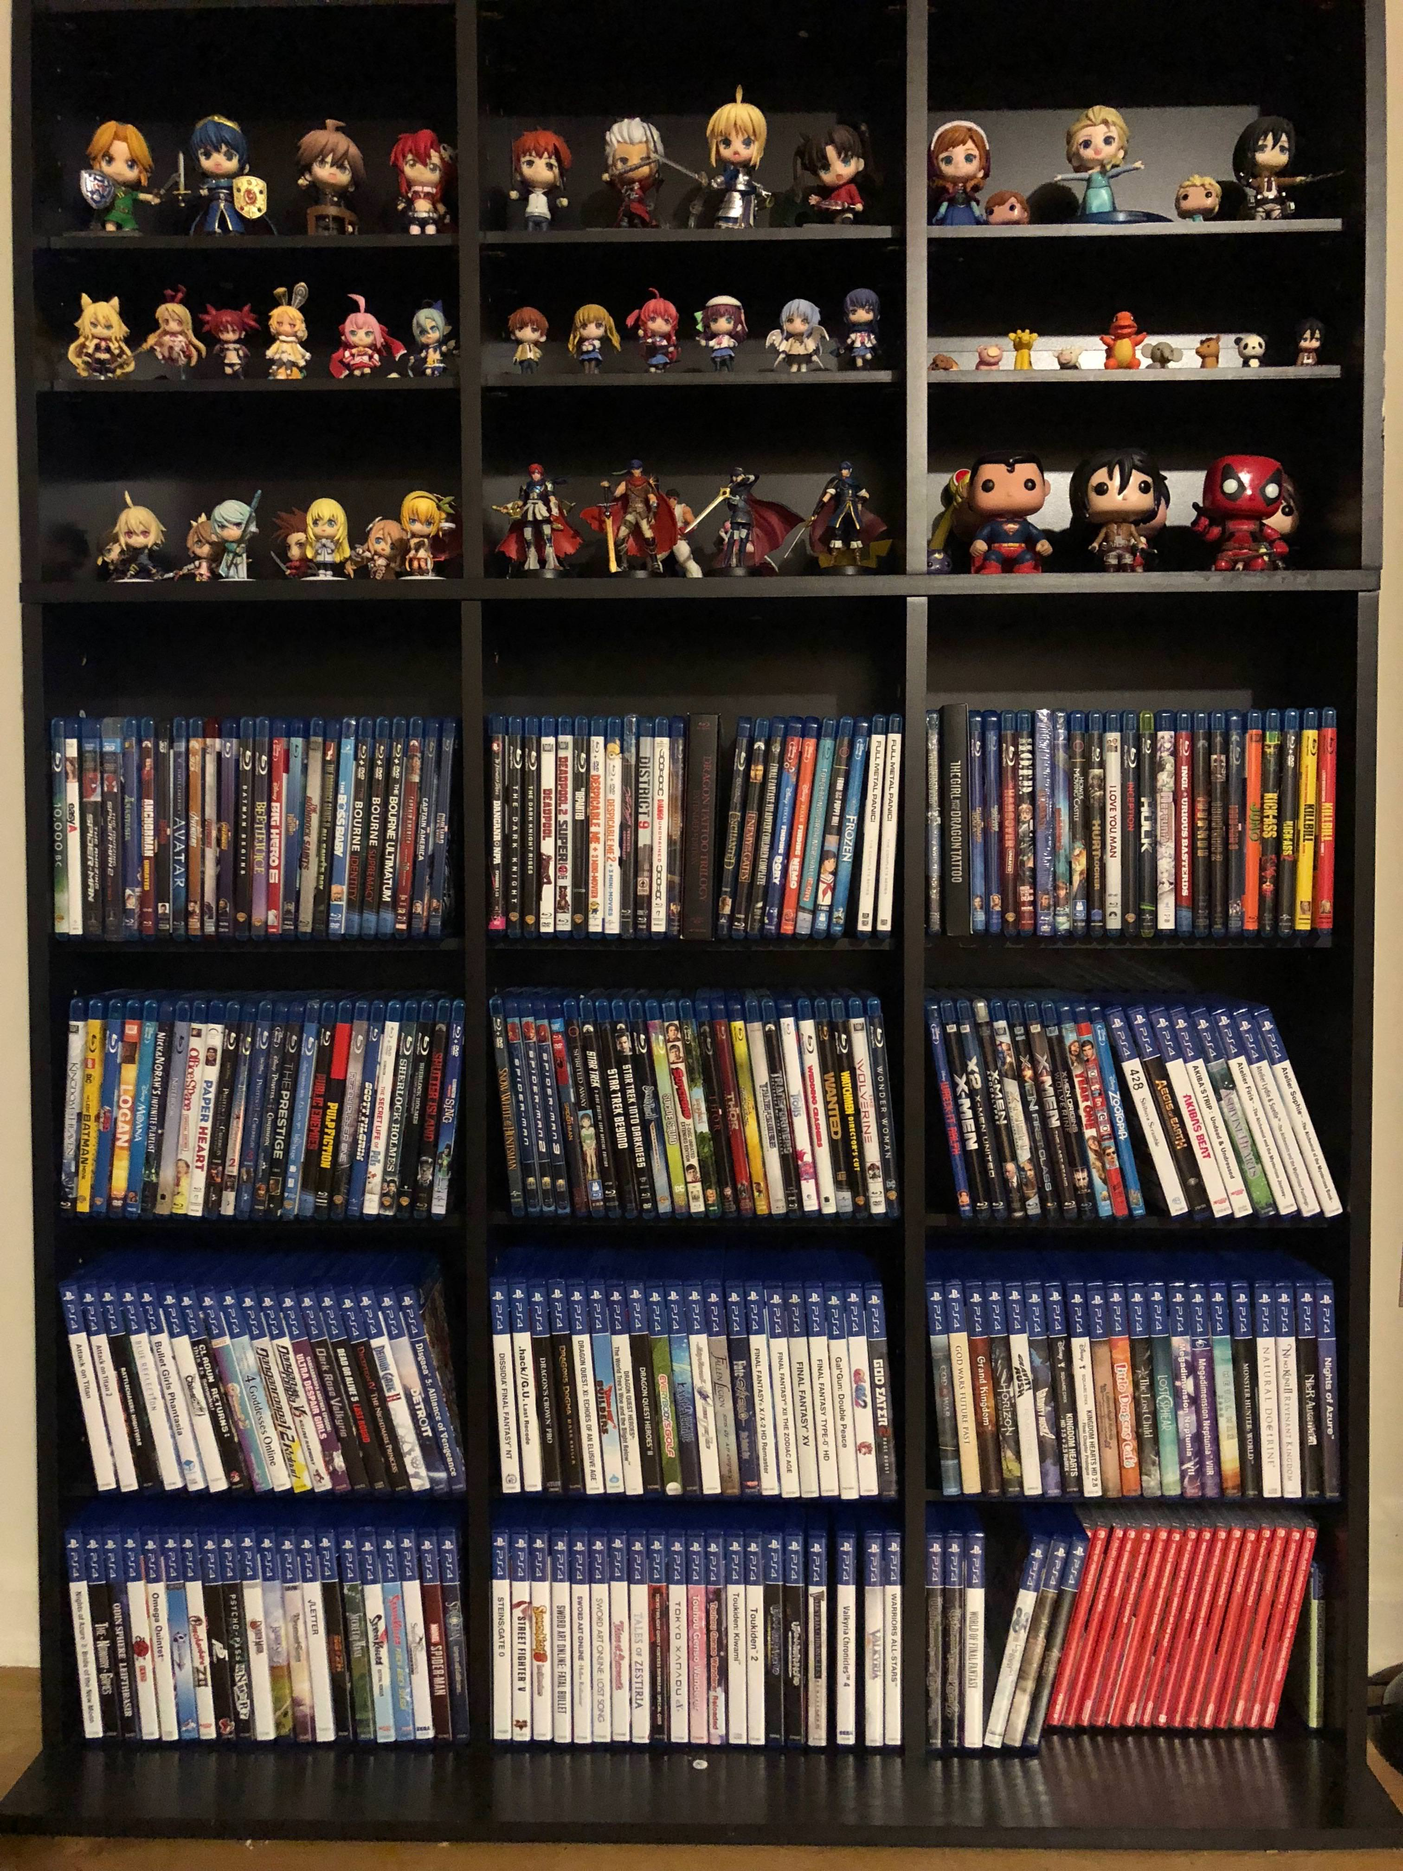
Shelvesets
A kind of changeset containing changes that have been temporarily set aside
Set aside, recall it for later if you like
Used in gated check-ins

Slide 19

Git – Pull Request
Push changeset
Interested parties review
Accept
Reject
Request changes

Slide 20
Policies - TFVC
Check Out
Multiple check-out
Get Latest on check-out
Check In
Changeset Comments
Work Items
Work Item Query Policy
Forbidden Patterns
Builds

Slide 21
Merging
Merge oldest to newest in list of approved changesets / work items
Plan merge times – daily at 9 am, weekly on Friday at noon
Create a playbook for each merge session
Review merge with base – XML can be valid but not compile
Tools
Git
KDiff3
WinMerge
Beyond Compare ($)
Notes:
https://davidburela.wordpress.com/2015/08/26/dev-tip-customising-visual-studio-to-use-a-different-merge-tool/

Slide 22
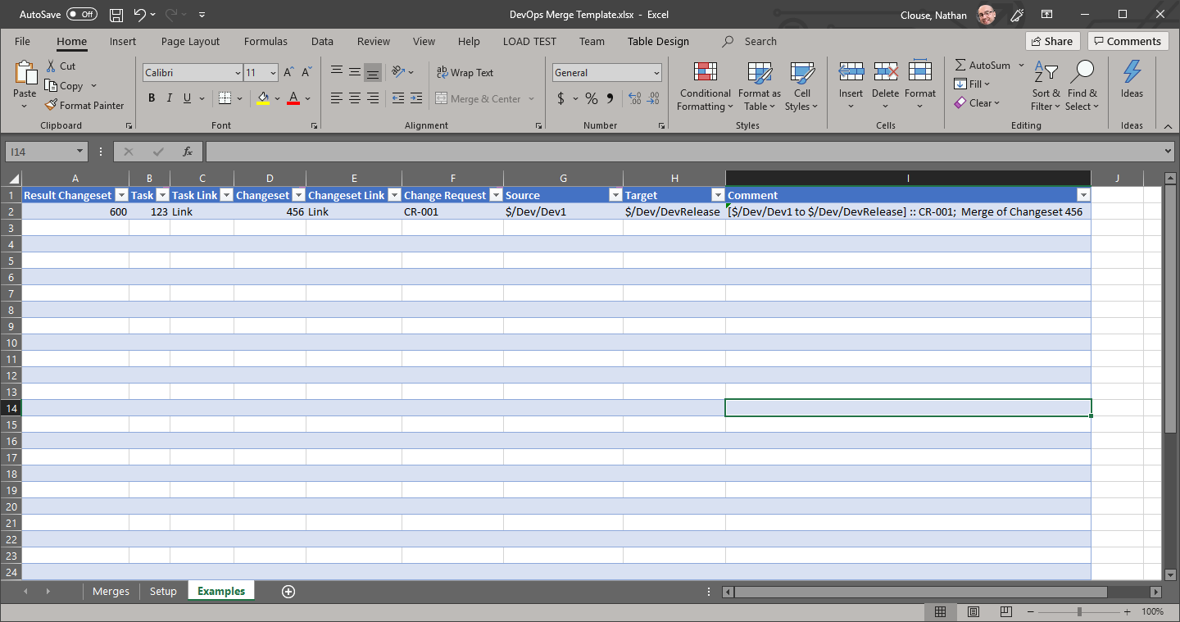
Merge Playbook Template
https://github.com/NathanClouseAX/DevOpsMergeTemplate
Free
MIT Licensed

Slide 23
Pipelines

Slide 24
Build

Slide 25

Continuous Integration (CI)
Automate build and test of code
For developers
Committing to shared branch (typically)
Better integrates teams and code
Bugs are caught earlier
Consistent quality
TFVC is Push
GIT is Pull
Reactive

Slide 26

Gated Check-ins
All the benefits of Continuous Integration
Proactive
Don’t have to create any artifacts
Typically choose one: gated check-ins or CI for a branch

Slide 27

Scheduled Builds
Run on a schedule – typically overnight

Slide 28
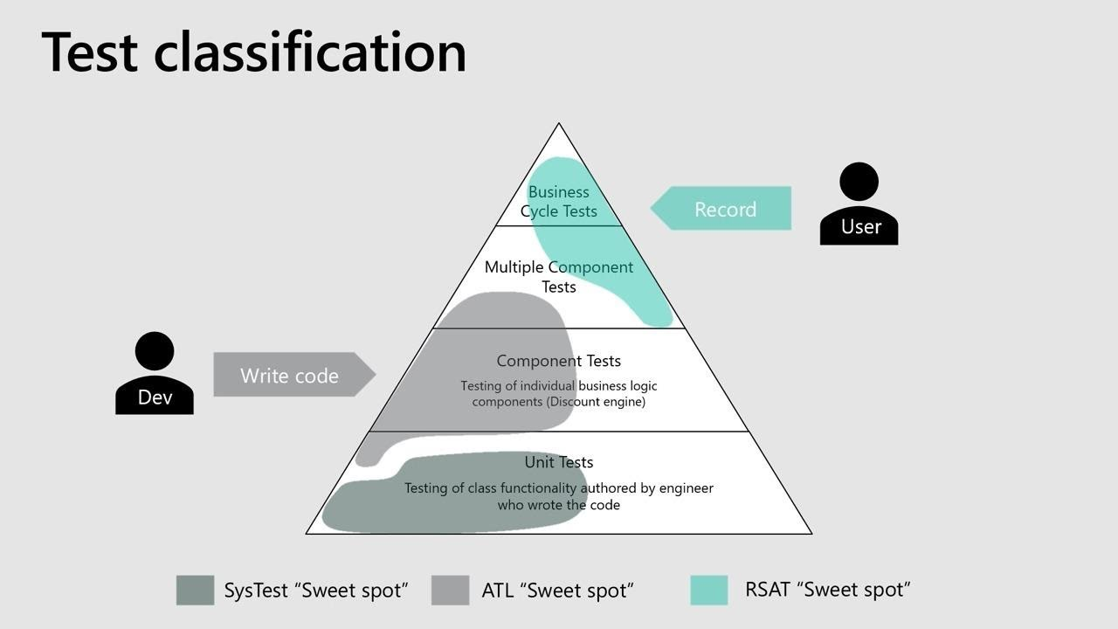
Gated Check-ins with Tests
SysTest
Automatic discovery
Built into build template
ATL (Acceptance Test Library)
Consistent
Discoverable
Performance

Slide 29

Release

Slide 30
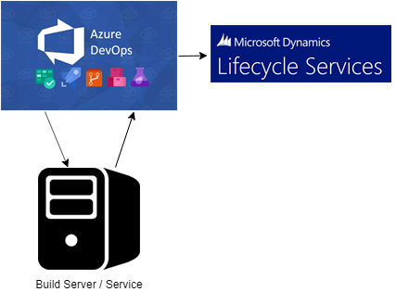
To LCS
Stores result in LCS for your build in your asset library
Easy to select from
No fuss
Notes:
https://community.dynamics.com/365/financeandoperations/b/dynamicsnavax/posts/azure-devops-release-pipeline-walkthrough

Slide 31
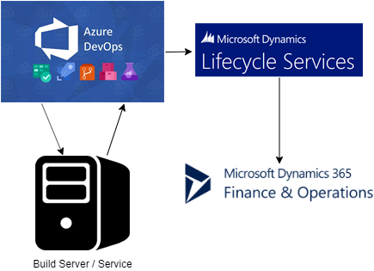
To an Environment (UAT)
Automatic deployment to a standard environment

Slide 32
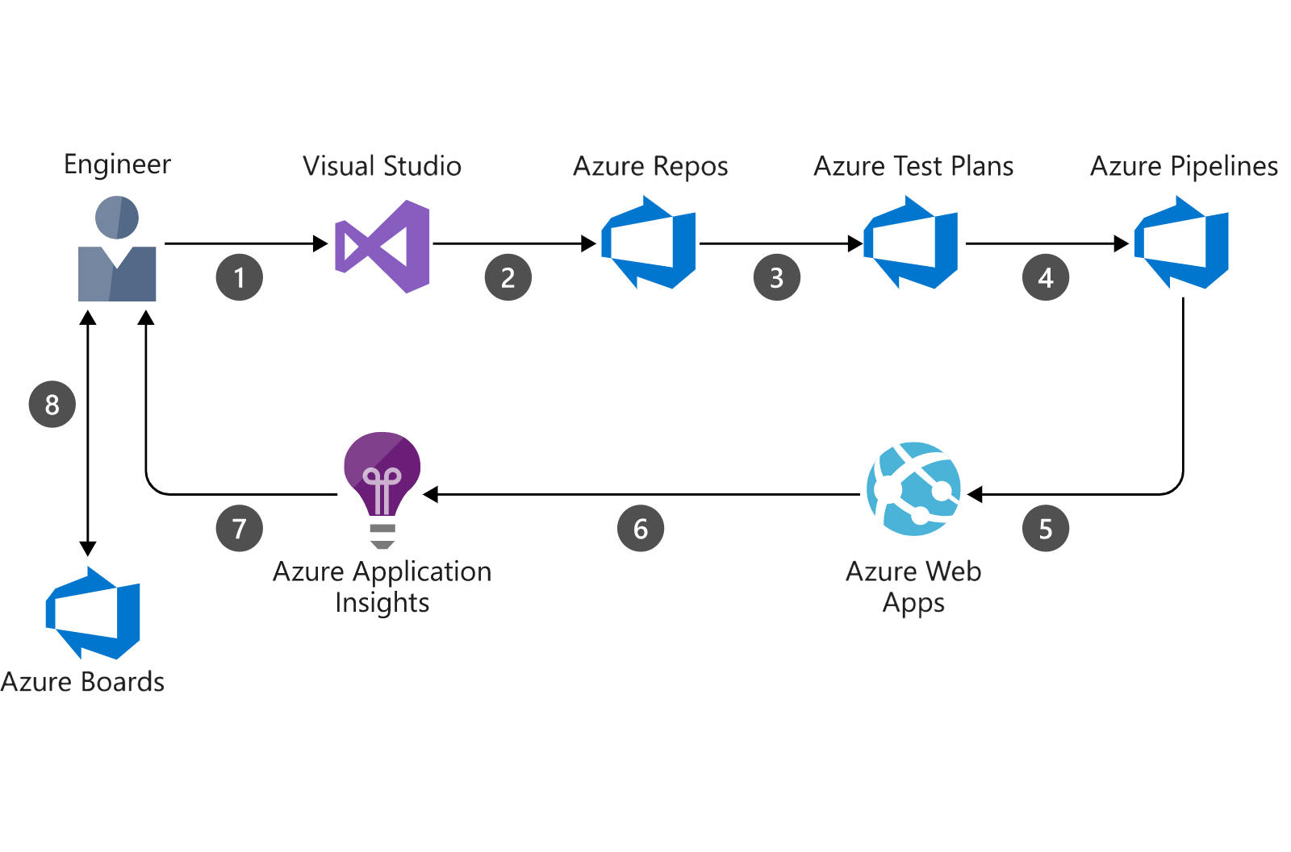
The New Feedback Loop

Slide 33
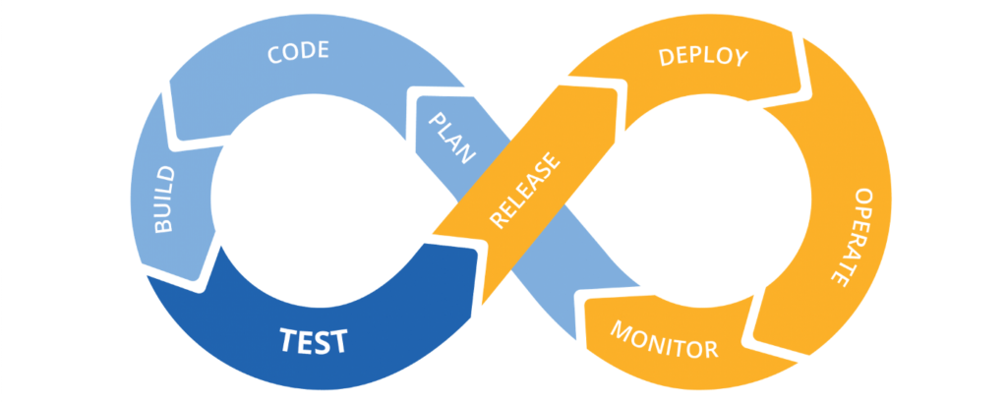

Slide 34

Questions?

Slide 35
Please Let Us Know Your Feedback
We want to hear what you think even if you think I’m terrible but want to be polite about it.
Image Credits: https://pixabay.com/, https://www.microsoft.com/en-us/, https://twitter.com/

Slide 36

Thank you! Please Complete The Survey!
https://www.linkedin.com/in/nathanclouseax/
https://twitter.com/NathanClouseAX
http://www.atomicax.com/
https://github.com/NathanClouseAX/
Nathan.Clouse@MCAConnect.com
Nathan Clouse
Technical Solution Architect
MCA Connect, LLC
AXUG Summit Track Leader
Nathan.clouse@mcaconnect.com
www.atomicax.com
@NathanClouseAX

